Slide 1
I/O Management

Slide 2
I/O Devices
External devices that engage in I/O with computer systems can be grouped into 3 categories:
1) Human readable:
Suitable for communicating with computer user
ex:Mouse ,keyboard, printers, display
2) Machine readable:
Suitable for communicating with electronic equipment
ex:Disk drives,USB keys,Sensors,Controllers
3) Communication:
Suitable for communicating with remote devices
ex:digital line drivers and modems

Slide 3
I/O Devices
Key differences across categories of I/O devices
1) Data rate
2) Application
3)Complexity of control
4) Unit of transfer
5) Data representation
6) Error Conditions

Slide 4
Basics of I/O
I/O Devices:
There are 3 categories of I/O devices:
1) Human Readable:
2) Machine Readable
3) Communication
Cable-
A Device communicates with computer system by sending signal over wire or cable(channel)
Port-
The devices communicates with machine via connection point or port(I/O port)

Slide 5
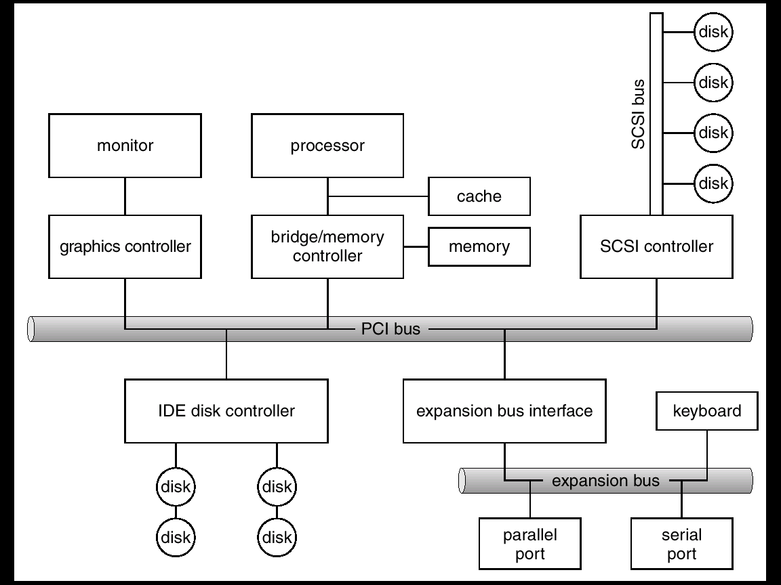
Device Controller:
It is a collection of electronics on a single chip that controls on the wires of a port.

Slide 6
Disk Controller consists of two units:
1) Channel(wire/bus)
2) Control Unit(CU)
All devices needs the device driver to be installed
on the system
Device Drivers(DD) conceptually consists of
four sub modules:
1) I/O procedure
2) I/O Scheduler
3)Device handler
4)Interrupt Service Routine(ISR)

Slide 7
Device Driver – 4 modules
I/O procedure:
1) As list of processes waiting for device changes with time to time and is updated at run time.
2) I/O procedure maintains this list using a data structure called as IORB.(Other data structure maintained are CCB,CUCB,DCB)
I/O Scheduler:
I/O scheduler sequences IORB chained to a DCB according to scheduling policy and picks IORB from chain when request is to be serviced.
Device handler :
It is piece if software which prepares an I/O program for the channel or controller.
Interrupt Service Routine(ISR):
An ISR (also called an interrupt handler) is a software process invoked by an interrupt request from a hardware device

Slide 8
Data structure maintained by I/O Procedure
CCB
1.Channel Id
2. Channels status
3. List of Control Units connected to this channel
4. List of processes waiting for this channel
5. Current process using this channel
6.Some other information
CUCB
1.Control Unit id
2. Control unit status
3. List of devices connected to this CU
4. List of processes waiting for this CU
5. Current process using this CU
6.Some other information
DCB
1.Device Id
2. Device status
3. Device characteristics
4.Device descriptors
5.List of CU s connected to this device
5.List of processes waiting for this device
6. Current process using this device
7.Some other information

Slide 9
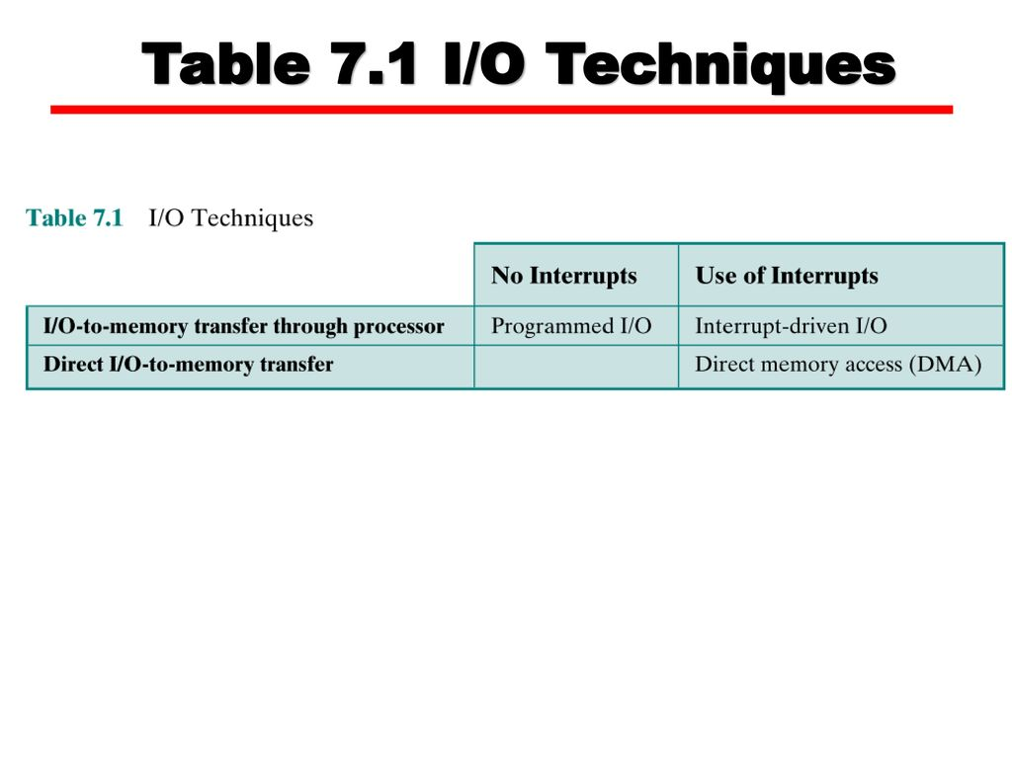
Organizations of I/O Functions
This includes 3 techniques for performing I/O:
Programmed I/O
Interrupt Driven I/O
Direct Memory Access

Slide 10
Programmed I/O or Polling
The processor issues an I/O command,on behalf of a process to an I/O module;That process then busy waits for the operation to be completed before proceedings
The host(CPU) and a controller interacts using
1) busy bit in status register
Busy bit=1 (by controller )– busy working
Busy bit=0(by controller)-ready to accept next command
2) Command ready bit in command register.
Command ready bit =1(by host) –command is available for controller.
Command ready bit =0(by host) –No command is available for controller.

Slide 11
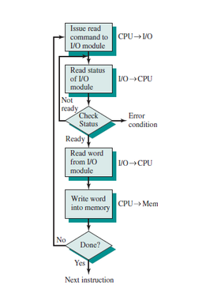
Flowchart of programmed I/O

Slide 12
Programmed I/O or Polling
Interaction between host and controller for write output through port:
The host repeatedly reads the busy bit until that bit becomes clear.
The host sets the write bit in the command register and writes a byte into the data-out register .
The host sets the command-ready bit.
When controller notices that command-ready bit is set, it sets the busy bit.
Controller reads the command register and sees the write command .It reads data-out register to get the byte, and does the I/O to the device.
Controller clears the command-ready bit, clears the error bit in the status register to indicates successful I/O. clear the busy
bit to indicate that it is finished.

Slide 13
Interrupt Driven I/O
If CPU does not poll busy bit in status register, then instead CPU receives interrupt when device is ready for next byte.
This is called as Interrupt driven I/O.
For this CPU hardware has a wire called the interrupt-request line that the CPU senses after executing every instruction.
Controller asserts interrupt request line.
CPU catches the interrupt and dispatches to interrupt handler.
Interrupt handler clears the interrupt by servicing the device.

Slide 14
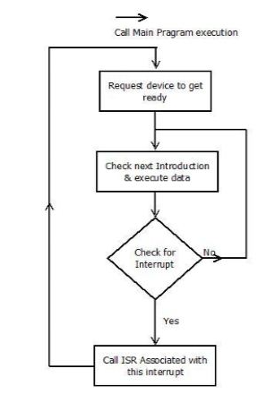
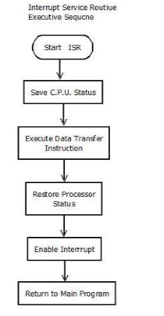
Flowchart of Interrupt-Driven I/O

Slide 15
DMA-Direct Memory Access
When processor wishes to read or write block of data it issues a command to DMA module by sending following information to the DMA module:
1) Whether a read or write is requested by showing on read or write control line between CPU and DMA
2) Address of the I/O device communicated on address lines
3) Starting location for read from and write to .
4) Data count-No. of words to read or write.

Slide 16
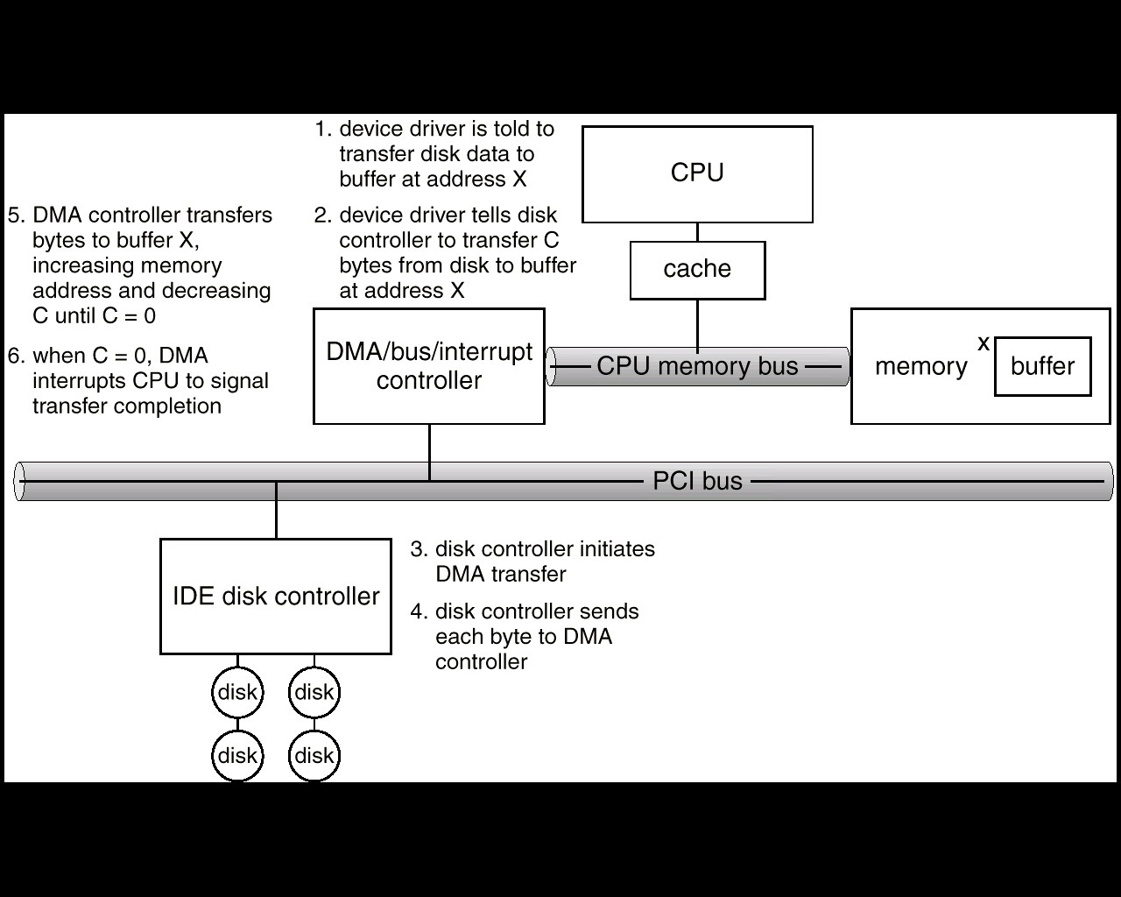
Six Step Process to Perform DMA Transfer

Slide 17
Disk Scheduling or I/O Scheduling

Slide 18
What is Disk
A disk is consisting of several Surfaces,
Each surface consisting of a no. of tracks
Each track is divided into no.of sectors.
Tracks are numbered from 0 to outermost track, with the increasing inwards.

Slide 19
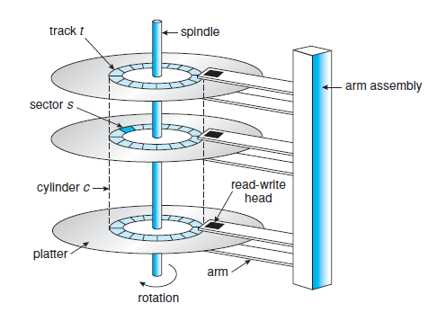

Slide 20
Disk Performance Factors
Seek time:
It is time required to move the disk arm to the required track
Rotational time or latency
It is the time required for the addressed area of the disk to rotate into a position where it is accessible by the R/W head.
Transmission time:
It is the transfer time required to or from the disk.

Slide 21
Disk Performance Factors
Ex:
File system asks device driver to read a block from
Surface 1.track 10,sector 5)
Current disk address=Surface 0,track 7,sector 4.
Target disk address=Surface 1,track 10,sector 5.
Seek time
Move arm for position
R/W head inwards from
track 7 to track 10.
Rotational delay
Time required until desired sector 5 comes under R/W head as disk rotates .
Transmission time
Activate R/W head for appropriate surface 1 and read the data
Total time to read=Seek time +Rotational time + Transmission
time

Slide 22
Disk Scheduling Techniques
FCFS(First Come First Serve)
SSTF(Shortest Seek Time First)
SCAN
C-SCAN(Circular scan)
LOOK
C-LOOK

Slide 23
Disk Scheduling
Note :
Scheduling of I/O gives importance to the disk arm movement i.e. basically seek time should be small.
Ex illustrating them with a request queue (0-199)
98, 183, 37, 122, 14, 124, 65, 67
Head pointer 53

Slide 24
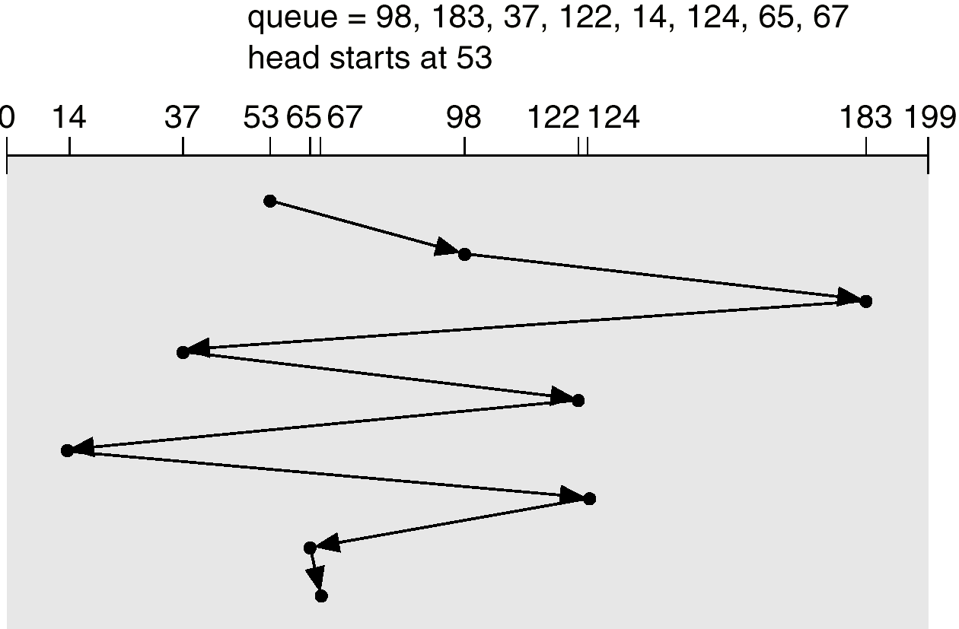
FCFS

Slide 25
SSTF
Selects the request with the minimum seek time from the current head position.
Ex illustrating them with a request queue (0-199)
98, 183, 37, 122, 14, 124, 65, 67
Head pointer 53
Seek time=abs(track no requested-current track position)

Slide 26
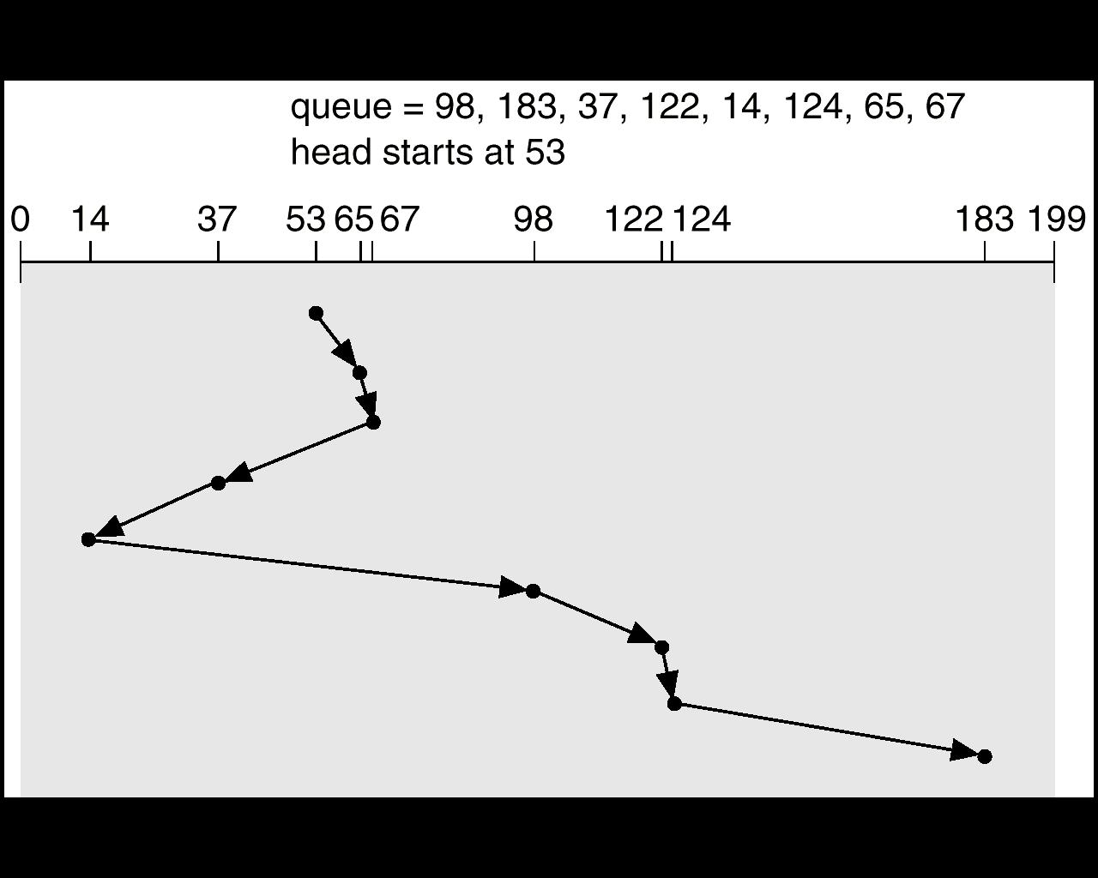
SSTF (Cont.)

Slide 27
SCAN
The arm is required to move in one direction only satisfying all outstanding request en route until it reaches the last track in that direction or until there are no more request in that direction.
Sometimes called the elevator algorithm.

Slide 28
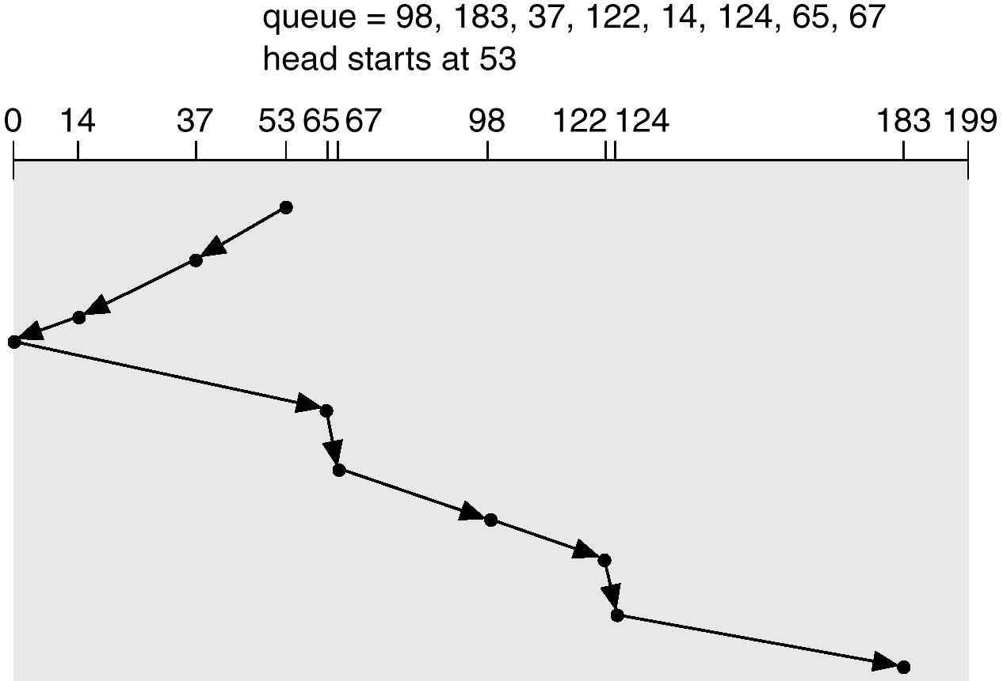
SCAN (Cont.)

Slide 29
C-SCAN
Provides a more uniform wait time than SCAN.
The head moves from one end of the disk to the other. servicing requests as it goes.
When it reaches the other end, however, it immediately returns to the beginning of the disk, without servicing any requests on the return trip.
Treats the cylinders as a circular list that wraps around from the last cylinder to the first one.

Slide 30
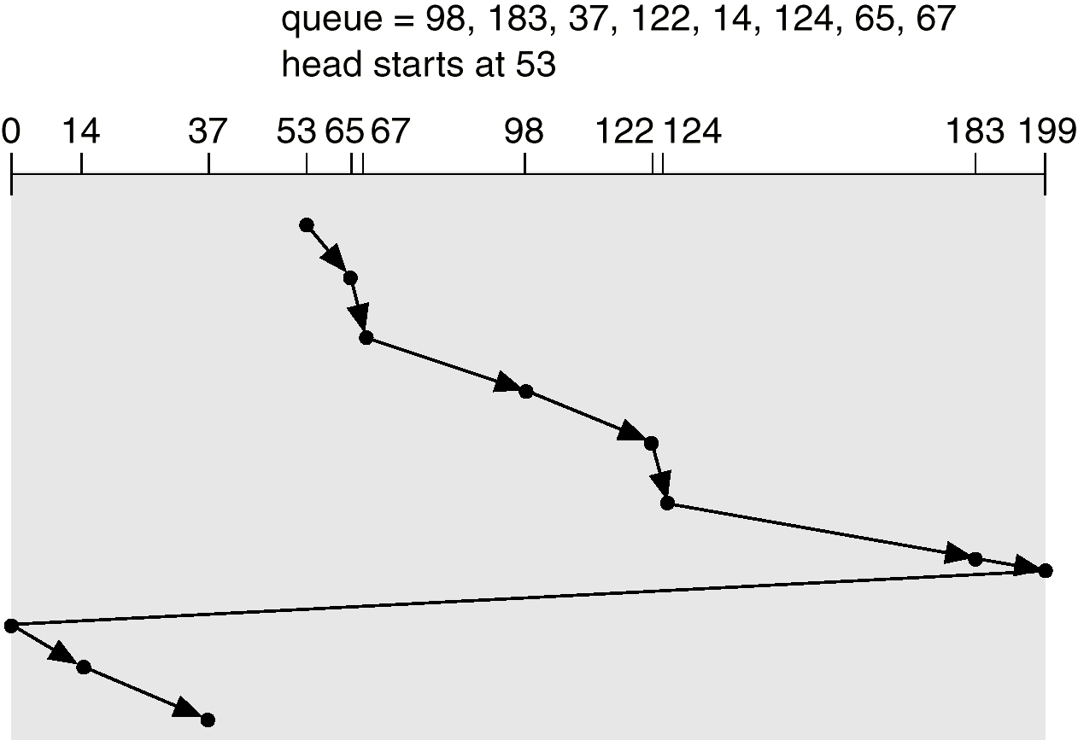
C-SCAN (Cont.)

Slide 31
LOOK
LOOK is the advanced version of SCAN (elevator) disk scheduling algorithm which gives slightly better seek time than any other algorithm in the hierarchy.
(FCFS->SRTF->SCAN->C-SCAN->LOOK)
The LOOK algorithm services request similarly as SCAN algorithm meanwhile it also “looks” ahead as if there are more tracks that are needed to be serviced in the same direction.
If there are no pending requests in the moving direction the head reverses the direction and start servicing requests in the opposite direction.

Slide 32
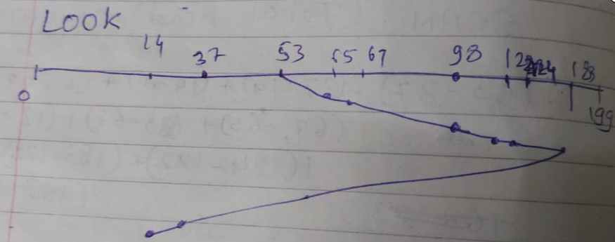
LOOK
Request sequence = {98,183,37,122,14,124,65,67}
Initial head position = 53
Direction = right (We are moving from left to right)
Seek sequence will be :65,67,98,122,124,183,37,14

Slide 33
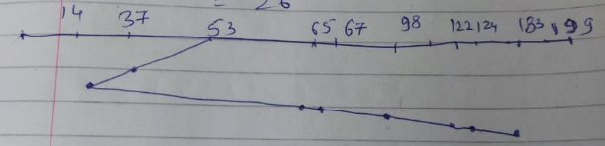
LOOK
Request sequence = {98,183,37,122,14,124,65,67}
Initial head position = 53
Direction = left (We are moving from right to left)
Seek sequence will be :37,14,65,67,98,122,124,183

Slide 34
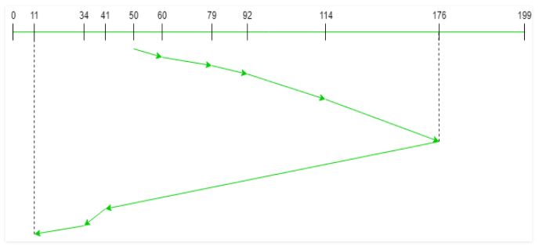
LOOK
Request sequence = {176, 79, 34, 60, 92, 11, 41, 114}
Initial head position = 50
Direction = right (We are moving from left to right)
Seek sequence will be : 60,79,92,114,176,41,34,11

Slide 35
C-LOOK
Arm only goes as far as the last request in each direction, then reverses direction immediately, without first going all the way to the end of the disk
C-LOOK it is called because they look for a request before continuing to move in a given direction.

Slide 36
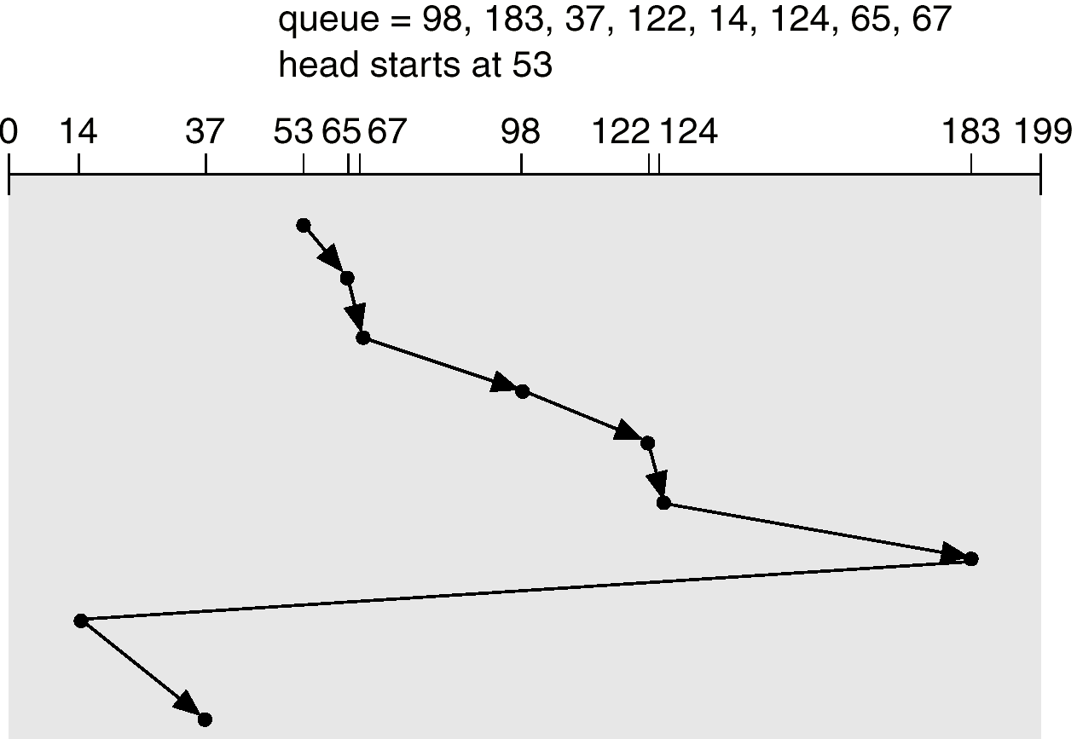
C-LOOK (Cont.)

Slide 37
Difference between SCAN and C-SCAN , LOOK and C-LOOK

Slide 38
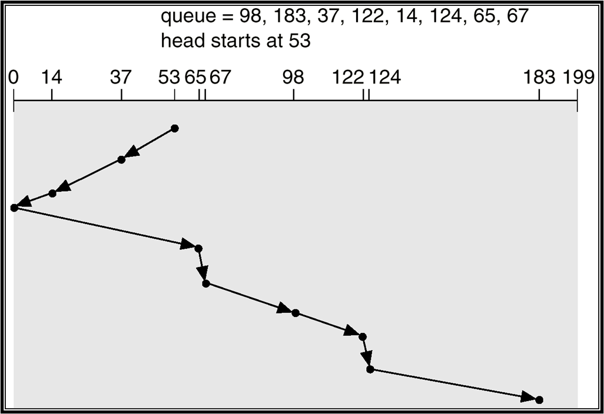
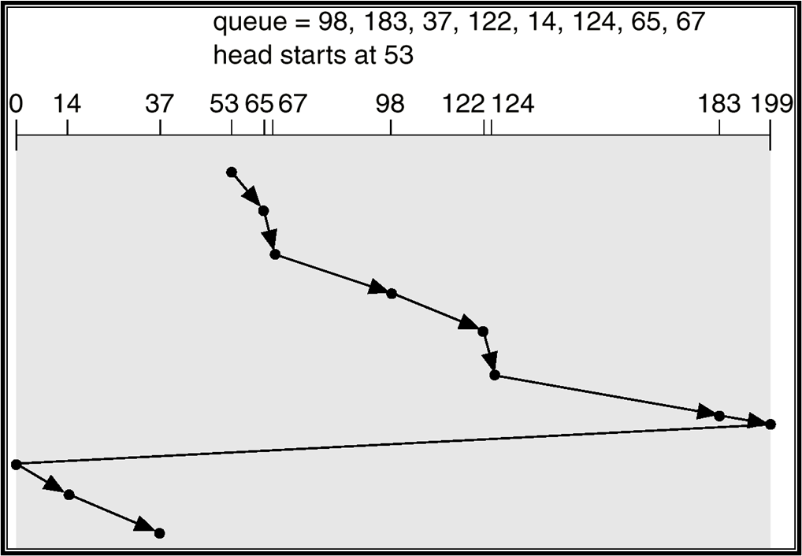
SCAN
C-SCAN

Slide 39

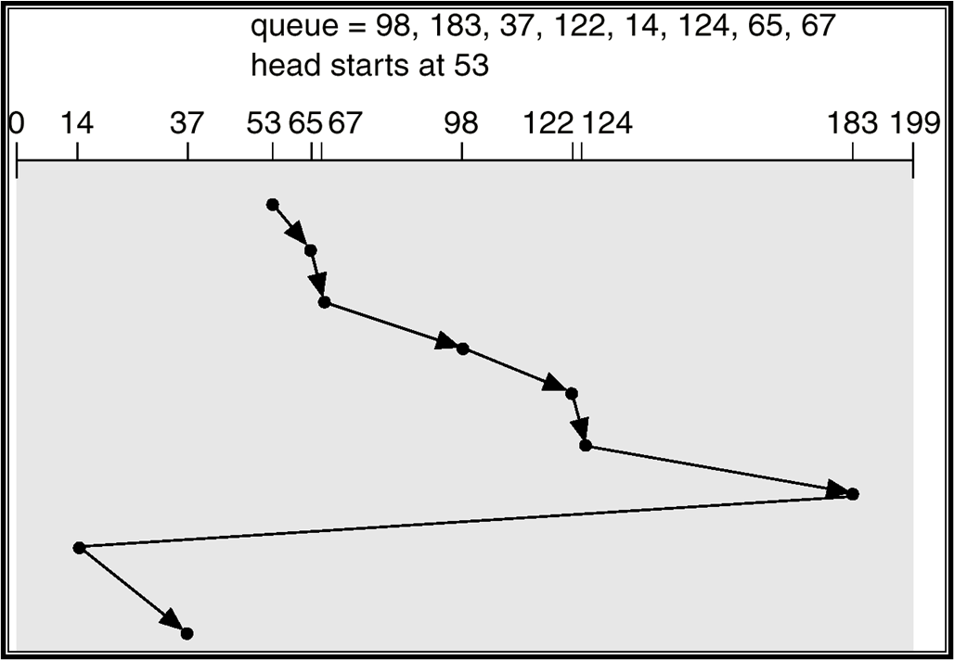
LOOK(Right Direction)
C-Look
LOOK(Left direction)

